Slide 1

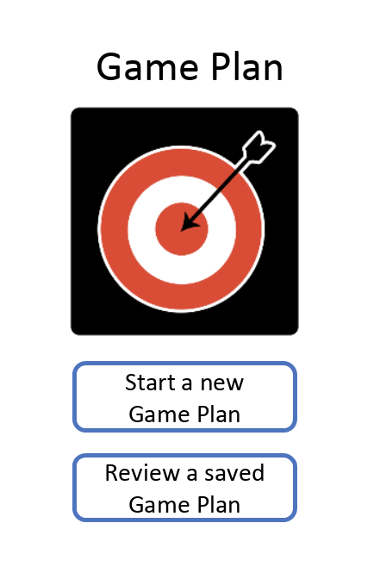
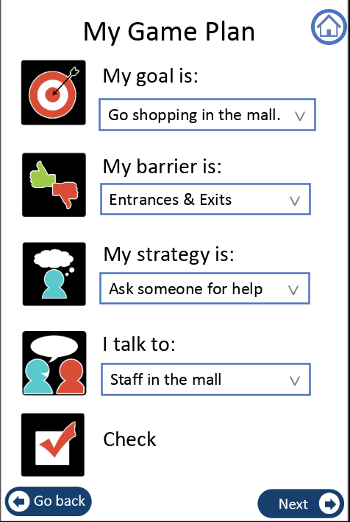
Game Plan
The use of classification algorithms in a goal-setting application for young adults with developmental and intellectual disabilities (DID)

Slide 2
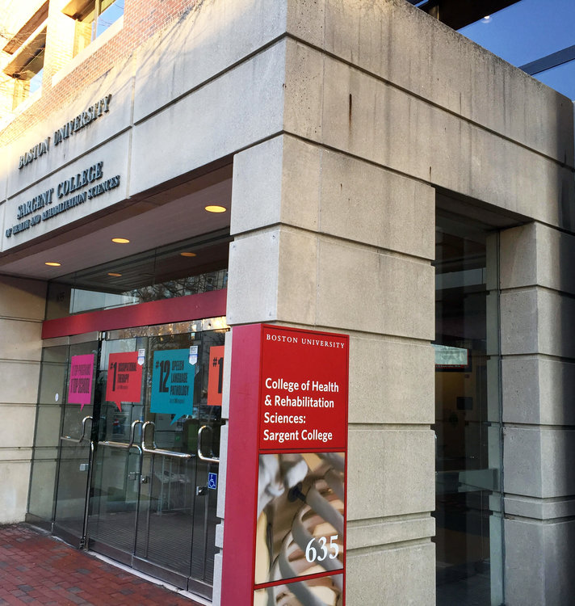
Background
Game Plan was initially a pen & paper methodology developed at Sargent College
GOAL: To help DID young adults transition into independent living
The project received a grant to fund mobile application development
Hariri Institute at BU has designed an initial version of the mobile application

Slide 3
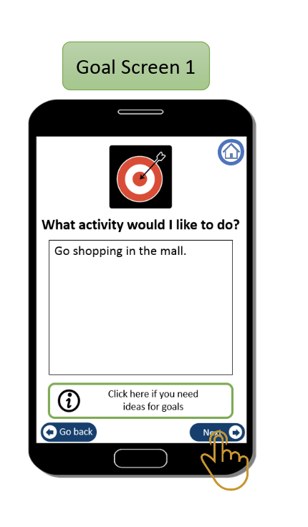
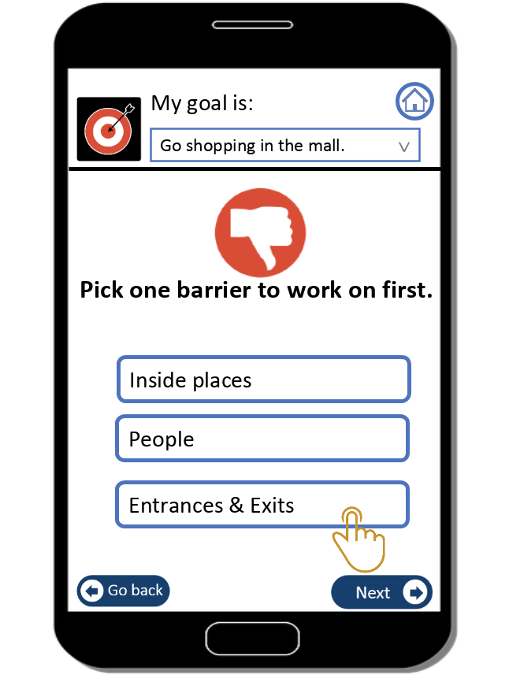
The Problem:
The application only features a hard-coded list of goals for the user to choose from. Users cannot set custom goals relevant to their own needs.
My Goal:
Develop a functionality that allows users to customize their goals in the Game Plan application

Slide 4
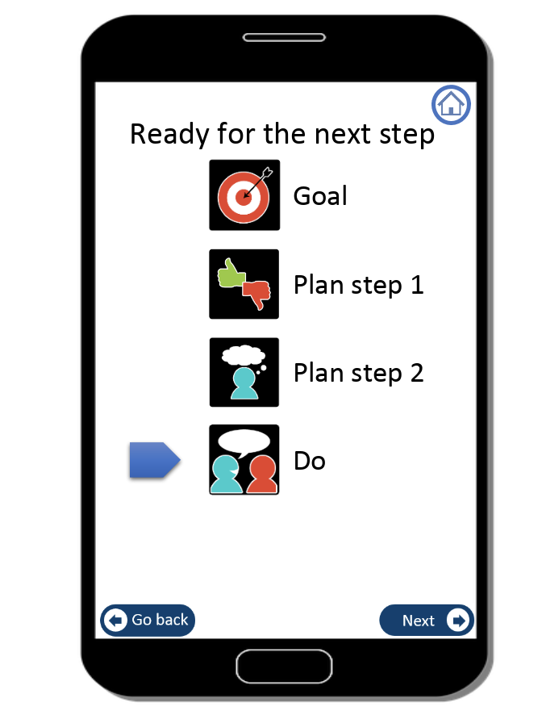
Example Workflow
Categories: work, school, fun, leisure
(input: “I want to get a summer job”: work)
category: work
(ie: “Ask for help with my resume”)

Slide 5
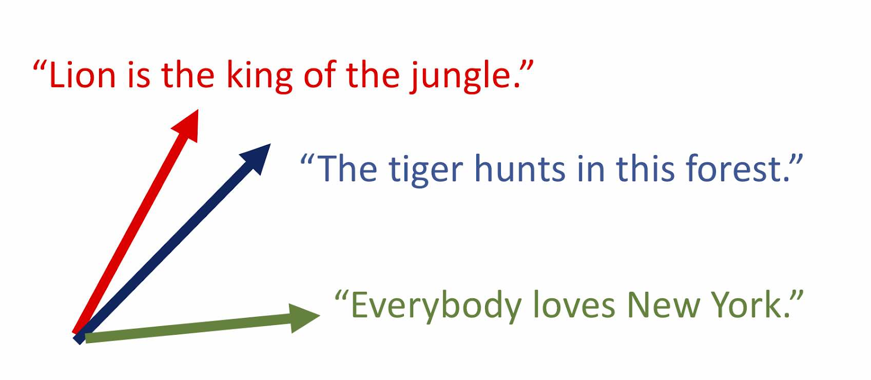
Step 1: Build dataset & vectorize Data
Create a dataset with sufficient example inputs for each goal category (work, school, self , fun)
Transform each text entry into a vector as a function of the # of times a word appears in a sentence and the number of sentences that include that word

Slide 6
Step 2: Split Data into Test, Train, and Cross-Validation Sets
80% of data was included in the training set

Slide 7
Step 3: Fit a k- Nearest Neighbor Model
Classify a data point based on the classification of its k-closest neighbors
K = 5
Accuracy = 89.4%

Slide 8
Step 4: Fit an SVC Model
Support Vector Machine : try to maximize “space” between classes
Trial & Error: fit model as a function of C, a a parameter that tells us how accurate we want our model to be (how large will the gap be?)
Susceptible to Overfitting: use cross-validation to mitigate

Slide 9
learnopencv.com

Slide 10
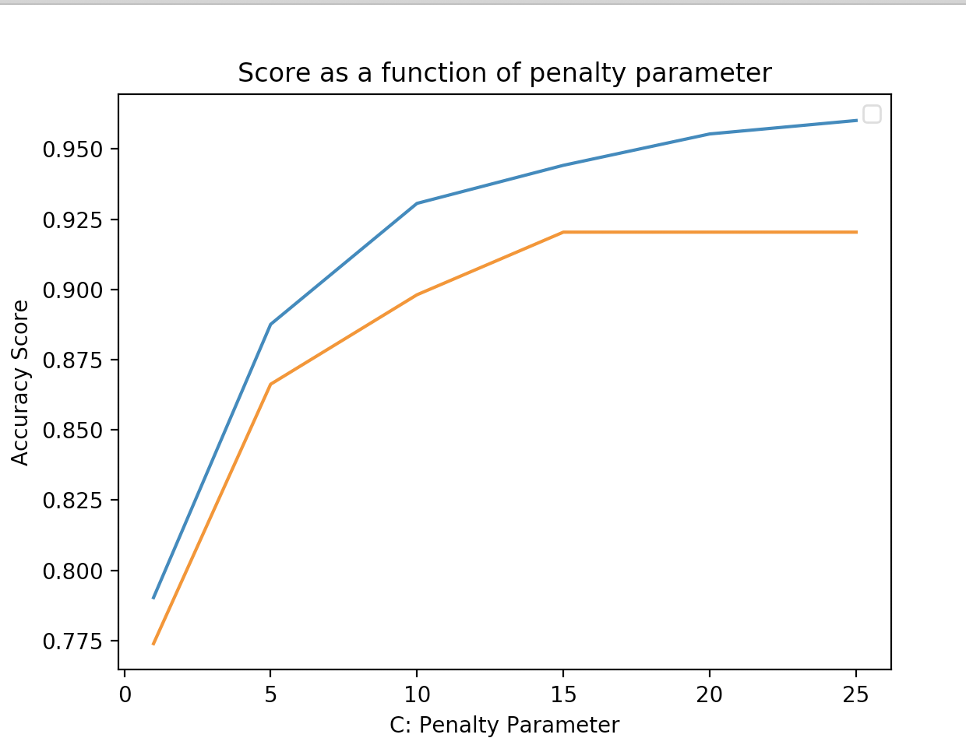
Cross-Validation Scores at Varying Values of C
C = 1
[0.28571429 0.28571429 0.3015873 0.3015873 0.22580645]
C = 5
[0.79365079 0.71428571 0.77777778 0.71428571 0.79032258]
C=10
[0.85714286 0.74603175 0.84126984 0.76190476 0.82258065]
C=15
[0.92063492 0.80952381 0.9047619 0.79365079 0.88709677]
C=20
[0.92063492 0.85714286 0.92063492 0.85714286 0.88709677]
C=25
[0.93650794 0.85714286 0.9047619 0.84126984 0.88709677]

Slide 11
Step 5: Create a Voting System
Source: stackexchange.com

Slide 12
In Conclusion
Developed an effective classification algorithm that will categorize user inputs
Functionality can be used to improve users experience with the app
Potential Next Steps:
Model can be built upon to learn from misclassification of a users input
Machine learning/classification can be used in other parts of the app
* i.e. Suggesting steps towards achieving goal/resolving potential roadblocks

Slide 13

Thank you!
Dora Erdos
Derry Wijaya
Lance Galletti

